Slide 1
2D Viewing and
Clipping

Slide 2
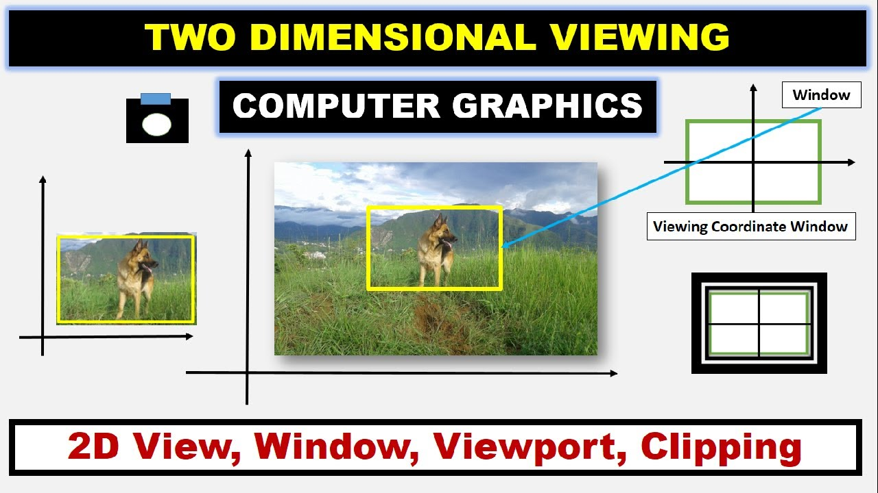
Introduction to 2D Viewing and Clipping
2D viewing and clipping are essential techniques in computer graphics for rendering a portion of a scene based on the viewer’s perspective. The 2D viewing process involves transforming real-world objects into a viewing coordinate system that maps them to a displayable area. This transformation is crucial for rendering only the visible parts of the scene.

Slide 3
Introduction to 2D Viewing and Clipping
Clipping is used to remove parts of objects that fall outside the visible area, known as the viewport. There are several types of clipping, such as line clipping and polygon clipping, which help in determining whether an object or part of an object should be displayed. The window-to-viewport transformation plays a significant role in mapping the visible portion from the world coordinates to screen coordinates

Slide 4
Two Dimensional Viewing: The Viewing Pipeline
The 2D Viewing Pipeline is a fundamental concept in computer graphics used to define how a scene is mapped from the world coordinate system to the display device. It involves a series of transformations that allow objects in a scene to be viewed from different perspectives and displayed within a specific window. Here’s an outline of the steps involved in the 2D viewing pipeline:

Slide 5
Two Dimensional Viewing: The Viewing Pipeline
World Coordinates
Window Definition
The World Coordinate System (WCS) is a global reference frame used in computer graphics to define the positions of objects in a scene. It acts as a universal coordinate system where all objects are initially defined and modeled. The objects in the scene are first defined in a world coordinate system (WCS).
A window is defined in the WCS. It represents the rectangular portion of the scene that the user wants to display. The window is defined by the minimum and maximum x and y coordinates (e.g., (x_{min},y_{min}) and (x_{max},y_{max}).

Slide 6
Two Dimensional Viewing: The Viewing Pipeline
Window – to – Viewport transformation
A transformation is applied to map the coordinates from the world window to the viewport. This involves scaling and translating the window coordinates so that they fit into the viewport.
The window-to-viewport transformation can be described mathematically as:
x_{v}=x_{vmin}+((x_{w}−x_{wmin}) / x_{wmax}−x_{wmin})(x_{vmax}−x_{vmin})
y_{v}=y_{vmin}+((y_{w}−y_{wmin}) / y_{wmax}−y_{wmin})(y_{vmax}−y_{vmin})

Slide 7
Two Dimensional Viewing: The Viewing Pipeline
Window – to – Viewport transformation
The window-to-viewport transformation can be described mathematically as:
x_{v}=x_{vmin}+((x_{w}−x_{wmin}) / x_{wmax}−x_{wmin})(x_{vmax}−x_{vmin})
y_{v}=y_{vmin}+((y_{w}−y_{wmin}) / y_{wmax}−y_{wmin})(y_{vmax}−y_{vmin})
Where:
(x_{w},y_{w}) are the window coordinates,
(x_{v},y_{v}) are the viewport coordinates,
(x_{wmin},y_{wmin}) and (x_{wmax},y_{wmax}) are the window boundaries,
(x_{vmin},y_{vmin}) and (x_{vmax},y_{vmax}) are the viewport boundaries.

Slide 8
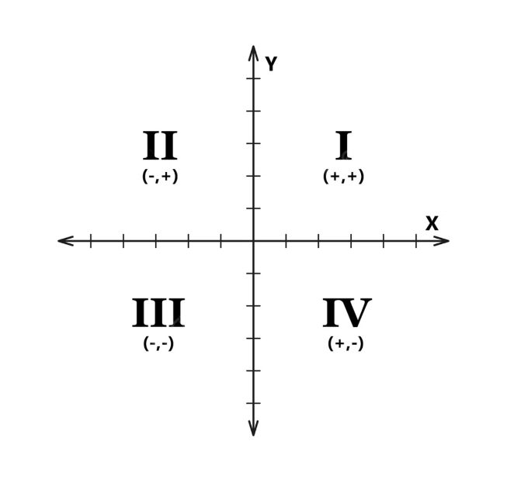
Two Dimensional Viewing: Viewing Coordinate Reference Frame
The Viewing Coordinate Reference Frame (also known as the Viewing Coordinate System, or VCS) is a coordinate system used in computer graphics to define how a scene or object is viewed. In two-dimensional (2D) viewing, the VCS helps in transforming objects from the World Coordinate System (WCS) to the Device Coordinate System (DCS) through intermediate steps, allowing for transformations like zooming, panning, or rotating the scene for viewing.

Slide 9
Two Dimensional Viewing: Viewing Coordinate Reference Frame
Key Concepts of the Viewing Coordinate Reference Frame:
1
Viewing Transformation: The viewing transformation is the process of mapping or transforming the world coordinates of objects (WCS) into a Viewing Coordinate System (VCS).
2
View Plane (Projection Plane): The view plane or projection plane is where
the objects in the viewing coordinate system are projected to form the final image.
3
Window in the Viewing Coordinate System: In the VCS, a viewing window is
defined, which corresponds to a rectangular portion of the scene in world
coordinates that the viewer wants to see.

Slide 10
Two Dimensional Viewing: Viewing Coordinate Reference Frame
Key Concepts of the Viewing Coordinate Reference Frame:
4
Alignment with the World Coordinate System (WCS): The viewing coordinate system is often aligned with the world coordinate system. However, transformations can occur to alter the view—such as translating, scaling, or rotating the window—in order to display different perspectives of the scene.
5
Clipping in VCS: Clipping in the viewing coordinate system ensures that only
objects within the defined window are displayed, while objects outside the
window are excluded from the final image.

Slide 11
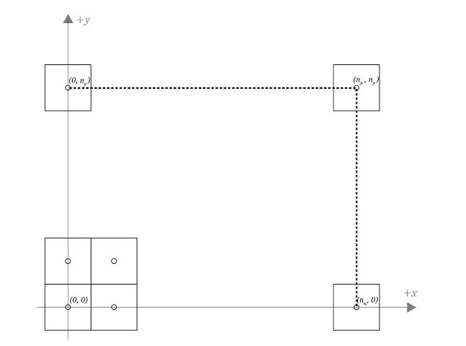
Window-to-Viewport Coordinate Transformation
Window-to-Viewport Coordinate Transformation is a key process in computer graphics used to map a portion of a 2D scene (defined by the window) onto a designated area of the display screen (defined by the viewport). This transformation ensures that the content within the window is scaled and positioned correctly within the viewport on the output device (such as a monitor or screen).

Slide 12
Window-to-Viewport Coordinate Transformation
Overview of Terms:
1
Window
The window represents a rectangular region in the world coordinate system (WCS) that defines the portion of the scene that we want to display.
It is defined by the boundaries (x_{wmin}, y_{wmin}) and (x_{wmax}, y_{wmax}) which represent the minimum and maximum x and y coordinates of the window.

Slide 13
Window-to-Viewport Coordinate Transformation
Overview of Terms:
2
Viewport
The viewport represents a rectangular area on the display coordinate system (DCS), or normalized device coordinates, where the window contents will be displayed.
It is defined by the boundaries (x_{vmin}, y_{vmin}) and (x_{vmax}, y_{vmax}), which represent the minimum and maximum x and y coordinates of the viewport.

Slide 14
Window-to-Viewport Coordinate Transformation
Purpose of Window-to-Viewport Transformation
The primary purpose is to ensure that the portion of the scene visible in the window is scaled and mapped to fit within the viewport, allowing different views of the scene to be displayed in different sizes or positions on the screen.

Slide 15
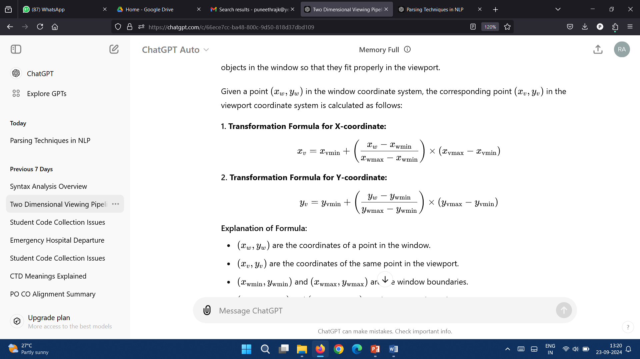
Window-to-Viewport Coordinate Transformation
Mathematical Representation of the Translation
Given a point (x_{w},y_{w}) in the window coordinate system, the corresponding point (x_{v},y_{v}) in the viewport coordinate system is calculated as follows:
1. Transformation Formula for X-coordinate:

Slide 16
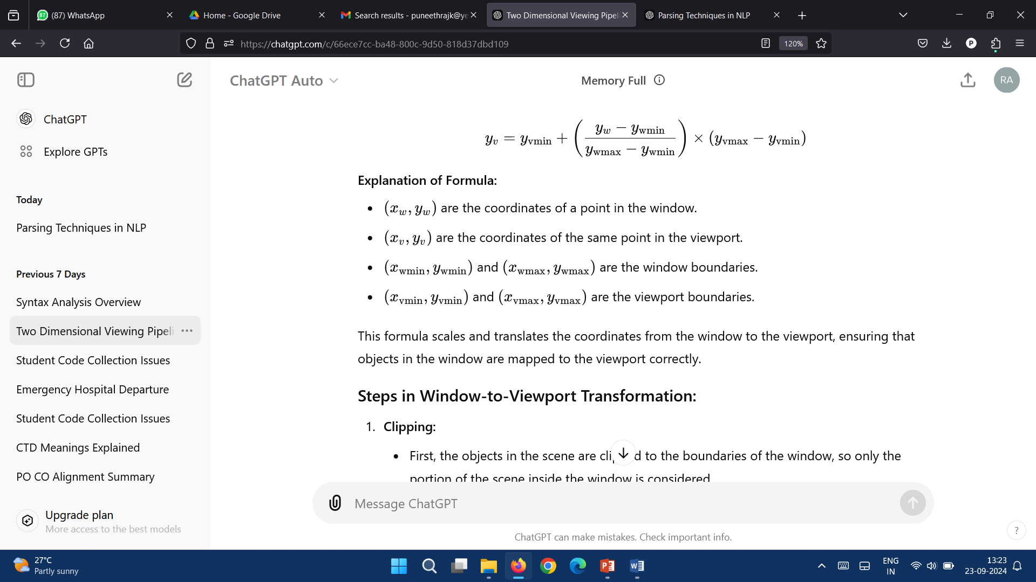
Window-to-Viewport Coordinate Transformation
Mathematical Representation of the Translation
2. Transformation Formula for Y-coordinate:

Slide 17
Window-to-Viewport Coordinate Transformation
Steps in Window-to-Viewport Transformation:
Clipping: First, the objects in the scene are clipped to the boundaries of the window, so only the portion of the scene inside the window is considered.
Scaling: The coordinates of the objects inside the window are then scaled proportionally to fit inside the viewport. The scaling factors for the x and y dimensions are derived from the ratio of the window size to the viewport size.
Translation: After scaling, the coordinates are translated so that the window’s position aligns with the viewport’s position on the display.

Slide 18
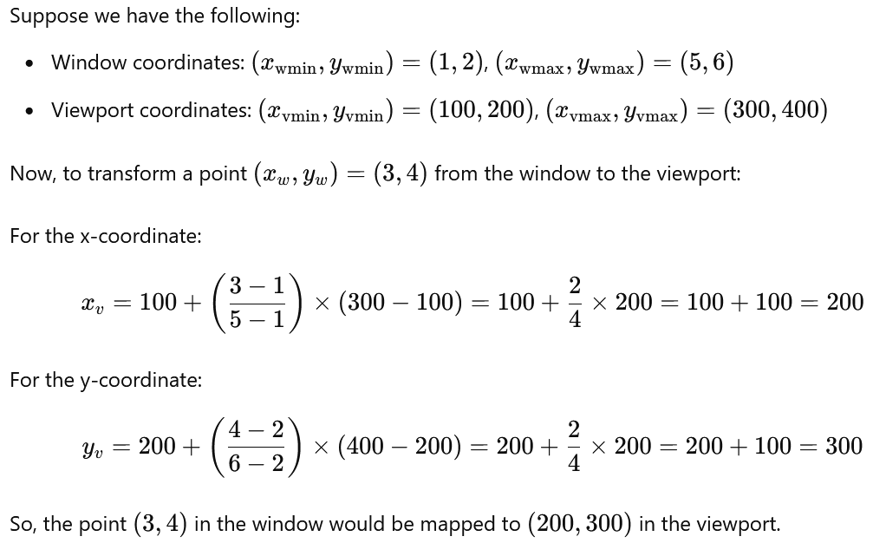
Window-to-Viewport Coordinate Transformation
Example

Slide 19
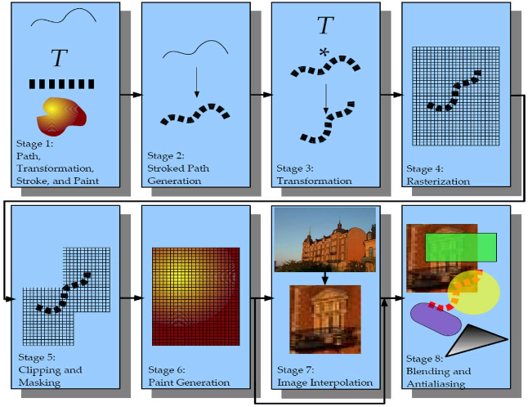
Transformations in OpenGL Clipping Operations
In OpenGL, 2D transformations are essential for manipulating the positions, orientations, and sizes of objects within the scene, and they play a key role in the clipping operations that ensure objects are properly displayed within the viewing area. Clipping is the process of determining which parts of a scene are visible in the viewport and discarding the rest.

Slide 20
Transformations in OpenGL Clipping Operations
2D Transformations in OpenGL:
OpenGL supports several types of 2D transformations that are used in various stages of rendering. These transformations are applied before the clipping process to position objects within the viewing volume. The common transformations include:

Slide 21
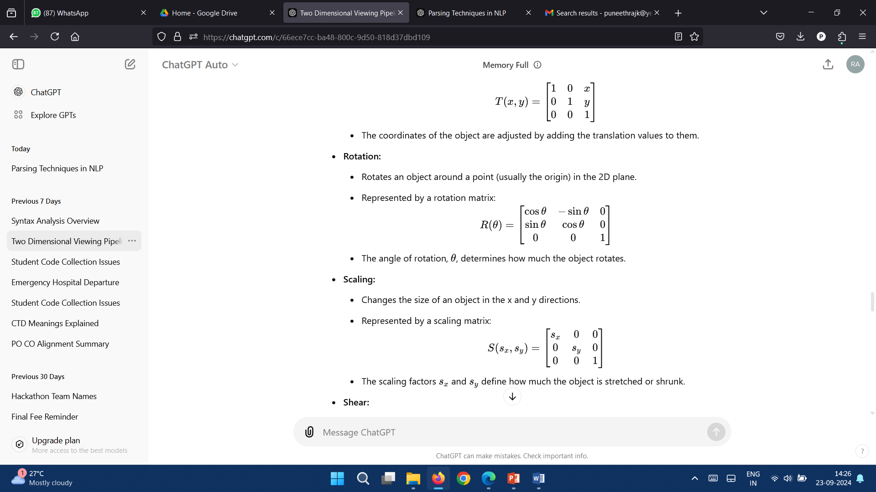
Transformations in OpenGL Clipping Operations
2D Transformations in OpenGL:
Translation:
Moves an object from one position to another in the 2D plane.
Represented by a translation matrix:
Rotation
Rotates an object around a point (usually the origin) in the 2D plane.
Represented by a rotation matrix:
The angle of rotation, θ, determines how much the object rotates.

Slide 22
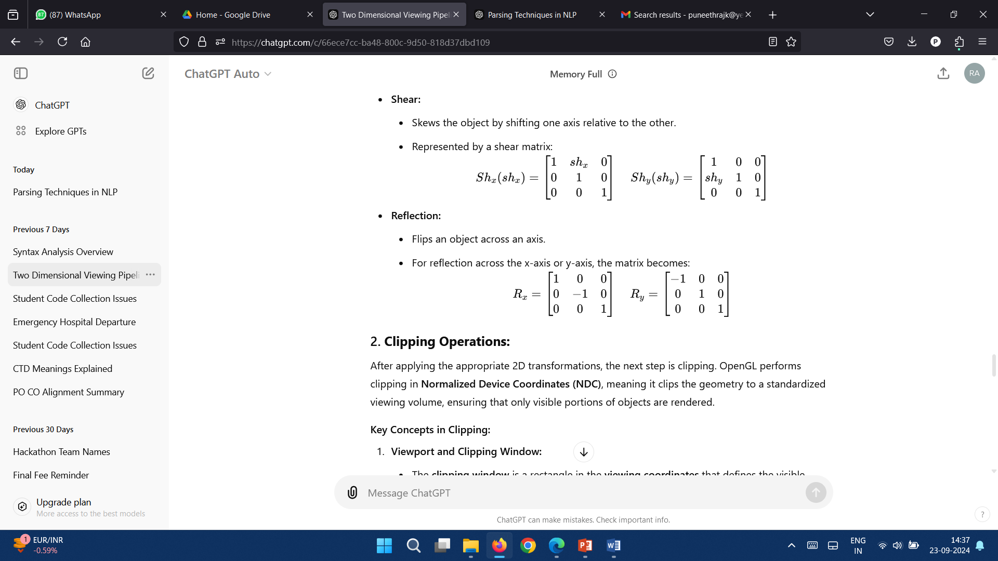
Transformations in OpenGL Clipping Operations
2D Transformations in OpenGL:
Scaling:
Changes the size of an object in the x and y directions.
Represented by a scaling matrix:
The scaling factors s_{x}​ and s_{y​} define how much the object is stretched or shrunk.
Shear:
Skews the object by shifting one axis relative to the other.
Represented by a shear matrix:

Slide 23
Transformations in OpenGL Clipping Operations
2D Transformations in OpenGL:
Reflection:
Flips an object across an axis.
For reflection across the x-axis or y-axis, the matrix becomes:

Slide 24
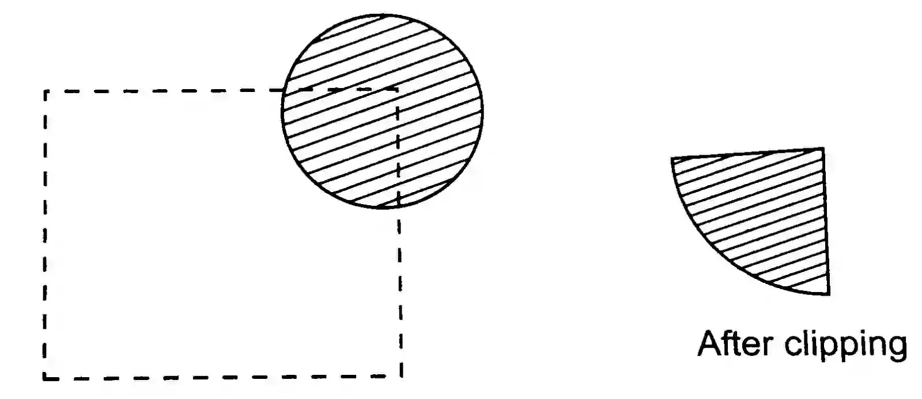
Transformations in OpenGL Clipping Operations
Clipping Operations
After applying the appropriate 2D transformations, the next step is clipping. OpenGL performs clipping in Normalized Device Coordinates (NDC), meaning it clips the geometry to a standardized viewing volume, ensuring that only visible portions of objects are rendered.

Slide 25
Transformations in OpenGL Clipping Operations
Viewport and Clipping Window:
The clipping window is a rectangle in the viewing coordinates that defines the visible region of the scene. Everything outside this window is clipped, or removed, from the scene.
OpenGL defines the clipping window in NDC as a 2D box with coordinates (−1,−1) to (1,1). This box defines the visible area of the scene after transformations are applied.

Slide 26
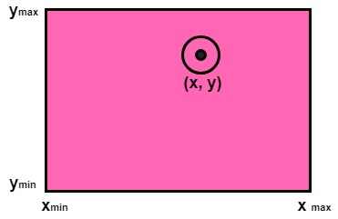
Transformations in OpenGL Clipping Operations
Point Clipping
Point clipping is the simplest form of clipping in computer graphics. It involves determining whether a given point is inside or outside a defined region, typically referred to as the clipping window or viewing window. If a point lies inside the clipping window, it is retained and rendered; if it lies outside, it is discarded.

Slide 27
Transformations in OpenGL Clipping Operations
Point Clipping: Clipping Window
The clipping window is usually defined as a rectangular area in 2D space. It is determined by specifying its minimum and maximum x and y coordinates:
This rectangular area forms the region where all visible points should be displayed.
x_{min}​: The minimum x-coordinate (left boundary)
x_{max}​: The maximum x-coordinate (right boundary)
y_{min}​: The minimum y-coordinate (bottom boundary)
y_{max}​: The maximum y-coordinate (top boundary)

Slide 28
Transformations in OpenGL Clipping Operations
Point Clipping: Conditions for Point Clipping
For a point P(x,y) to be inside the clipping window, the following conditions must be satisfied:
x_{min} ​ ≤ x ≤ x_{max}
y_{min}​ ≤ y ≤ y_{max}​
If all the above conditions are met, the point is inside the clipping window, and it will be displayed. Otherwise, the point is outside the window and is clipped (i.e., not displayed).
​

Slide 29
Transformations in OpenGL Clipping Operations
Point Clipping: Example
Let’s assume a clipping window is defined with the following coordinates:
x_{min} ​= 10, x_{max} ​= 100, y_{min ​}= 20, y_{max} ​= 80
Now, given a point P(30,50), we can check if it satisfies the conditions:
x_{min} ​≤ x ≤ x_{max}​ becomes 10 ≤ 30 ≤ 100, which is true.
y_{min} ​≤ y ≤ y_{max}​ becomes 20 ≤ 50 ≤ 80, which is also true.
Since both conditions are true, the point P(30,50) is inside the clipping window and will be displayed.

Slide 30
Transformations in OpenGL Clipping Operations
Point Clipping: Example
x_{min} ​= 10, x_{max} ​= 100, y_{min ​}= 20, y_{max} ​= 80
Now, given a point Q(150,50), we can check if it satisfies the conditions:
x_{min} ​≤ x ≤ x_{max}​ becomes 10 ≤ 150 ≤ 100, which is false because 150 is greater than x_{max}=100.
Thus, the point Q(150,50) lies outside the clipping window and will be clipped (not displayed).

Slide 31
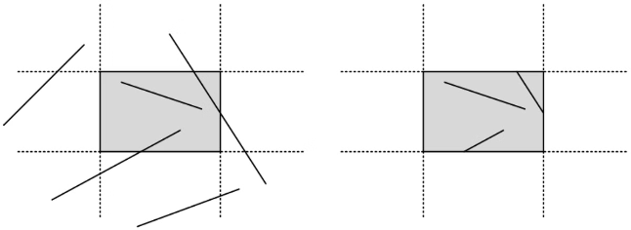
Transformations in OpenGL Clipping Operations
Line Clipping
Cohen-Sutherland line clipping is a widely-used algorithm for clipping lines in 2D space. It determines whether a line segment is visible, partially visible, or completely outside the clipping window and clips the portion that lies outside the window. The algorithm uses a divide-and-conquer approach to decide the visibility of a line segment by assigning region codes to endpoints and performing logical operations.

Slide 32
Transformations in OpenGL Clipping Operations
Line Clipping: Region Codes
Each endpoint of a line is assigned a 4-bit region code based on its position relative to the clipping window. The bits represent the position of the point in relation to the top, bottom, right, and left edges of the clipping window.

Slide 33
Transformations in OpenGL Clipping Operations
Line Clipping: Region Codes
Each bit in the 4-bit region code corresponds to a position:
Bit 1 (Top): The point is above the window (y > y_{max}).
Bit 2 (Bottom): The point is below the window (y < y_{min}​).
Bit 3 (Right): The point is to the right of the window (x > x_{max}​).
Bit 4 (Left): The point is to the left of the window (x<x_{min}​).
For each endpoint of the line segment, a region code is generated. The region code helps to identify whether the point is inside or outside the window and, if outside, which side of the window it lies.

Slide 34
Transformations in OpenGL Clipping Operations
Line Clipping: Steps of the Cohen-Sutherland Algorithm
1. Assign region codes:
For each endpoint of the line, assign a 4-bit region code based on its position relative to the clipping window (top, bottom, left, right).
2. Check for trivial acceptance or rejection:
If both endpoints are inside the window (region codes are 0000), accept the line without clipping.
If both endpoints are completely outside in the same region (logical AND of the region codes is not 0), reject the line.

Slide 35
Transformations in OpenGL Clipping Operations
Line Clipping: Steps of the Cohen-Sutherland Algorithm
3. Clip the line:
If part of the line is inside and some of the part is outside, calculate where the line crosses the clipping window edges.
Replace the endpoints with the intersection points and repeat the process until the line is fully inside or rejected.

Slide 36
Transformations in OpenGL Clipping Operations
Line Clipping: Example
Let's go through an example using the Cohen-Sutherland algorithm.
Clipping Window:
x_{min} = 10
x_{max} = 100
y_{min} = 10
y_{max} = 100
For a point P(x,y), the region code is determined as follows:
(0,0,0,0): The point is inside the clipping window.
(0,0,1,0): The point is to the right of the window.
(0,1,0,0): The point is below the window.

Slide 37
Transformations in OpenGL Clipping Operations
Line Clipping: Example
Line Segment:
Let the line segment have endpoints P1(5,5) and P2(80,120).
1. Assign region codes:
P1(5,5): This point is to the left of the window (x < x_{min}​) and below the window (y < y_{min}​).
Region code: 0101 (left, bottom).
P2(80,120): This point is inside the horizontal boundaries but above the window (y > y_{max}​).
Region code: 1000 (top).

Slide 38
Transformations in OpenGL Clipping Operations
Line Clipping: Example
Line Segment:
Let the line segment have endpoints P1(5,5) and P2(80,120).
2. Check for trivial acceptance/rejection:
The region codes of P1 and P2 are 0101 and 1000, respectively.
The logical AND of these codes is 0000, meaning there is no overlap in the region codes that indicate both points are in the same non-visible region, so the line is not trivially rejected.

Slide 39
Transformations in OpenGL Clipping Operations
Line Clipping: Example
Line Segment:
Let the line segment have endpoints P1(5,5) and P2(80,120).
3. Clip the line:
We need to find the intersection points where the line crosses the clipping window boundaries.

Slide 40
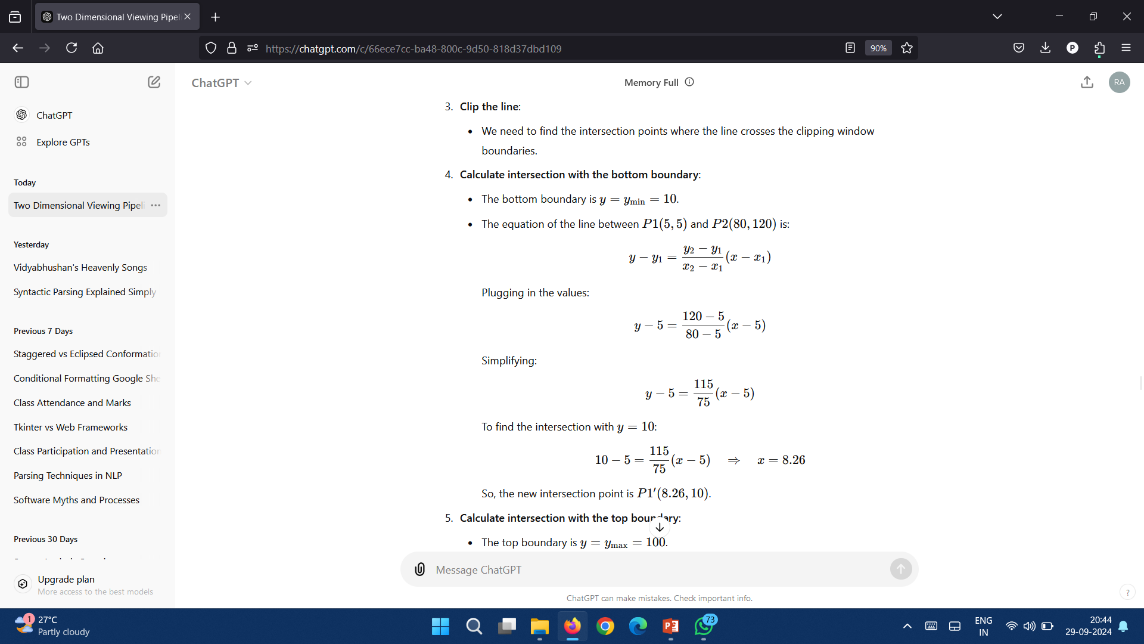
Transformations in OpenGL Clipping Operations
Line Clipping: Example
Line Segment:
Let the line segment have endpoints P1(5,5) and P2(80,120).
4. Calculate intersection with the bottom boundary:
The bottom boundary is y = y_{min} = 10.
The equation of the line between P1(5,5) and P2(80,120) is:
Plugging in the values:

Slide 41
Transformations in OpenGL Clipping Operations
Line Clipping: Example
Line Segment:
Let the line segment have endpoints P1(5,5) and P2(80,120).
Simplifying:
To find the intersection with y=10:
So, the new intersection point is P1′(8.26,10).

Slide 42
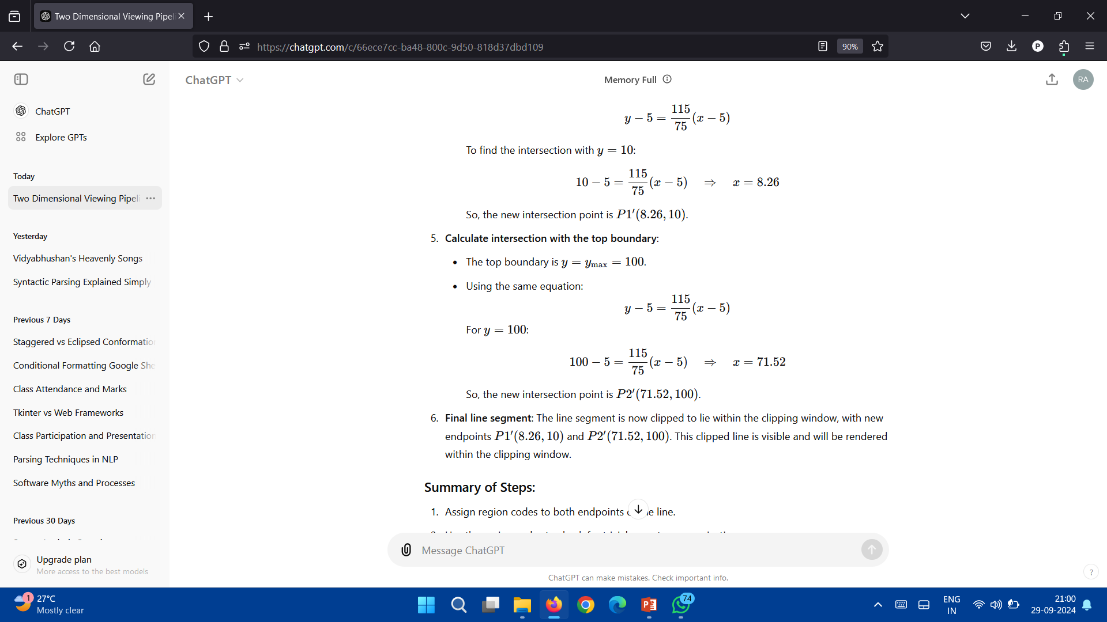
Transformations in OpenGL Clipping Operations
Line Clipping: Example
Line Segment:
Let the line segment have endpoints P1(5,5) and P2(80,120).

Slide 43
Transformations in OpenGL Clipping Operations
Line Clipping: Example
Line Segment:
Let the line segment have endpoints P1(5,5) and P2(80,120).

Slide 44
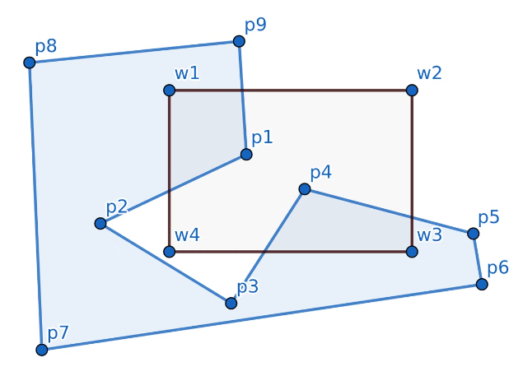
Transformations in OpenGL Clipping Operations
Polygon Clipping – Sutherland – Hodgeman Polygon Clipping
The Sutherland – Hodgman Polygon Clipping algorithm is used to clip polygons (convex or concave) against a rectangular clipping window. It works by processing each edge of the polygon against each edge of the clipping window one at a time.

Slide 45
Transformations in OpenGL Clipping Operations
Polygon Clipping – Sutherland – Hodgeman Polygon Clipping
Steps of the Algorithm:
Start with the polygon and the clipping window.
Clip the polygon edge by edge against each boundary of the clipping window (left, right, top, bottom).
For each edge of the clipping window, process the vertices of the polygon:
Four cases arise for each vertex:
Inside → Inside: Add the second vertex to the output list.
Inside → Outside: Add the intersection point to the output list.
Outside → Inside: Add the intersection point and the second vertex to the output list.
Outside → Outside: No vertex is added to the output list.
After processing all edges, the resulting output is the clipped polygon.

Slide 46
Transformations in OpenGL Clipping Operations
Polygon Clipping – Sutherland – Hodgeman Polygon Clipping
Example
Let’s take a simple polygon with 4 vertices (forming a square) and a rectangular clipping window.
Initial Polygon Vertices:
P1(20,30)
P2(70,30)
P3(70,60)
P4(20,60)

Slide 47
Transformations in OpenGL Clipping Operations
Polygon Clipping – Sutherland – Hodgeman Polygon Clipping
Example: Clipping Window:
Left boundary: x=30
Right boundary: x=60
Bottom boundary: y=40
Top boundary: y=50

Slide 48
Transformations in OpenGL Clipping Operations
Polygon Clipping – Sutherland – Hodgeman Polygon Clipping
Example: Clipping Window:
1. Clip against the left boundary x=30:
P1(20,30) is outside, and P2(70,30) is inside. So, we add the intersection point (30,30) and P2(70,30).
P3(70,60) and P4(20,60): Similar clipping is done, adding necessary points and intersections. Resulting points: (30,60),(60,60),(60,50),(30,50).

Slide 49
Transformations in OpenGL Clipping Operations
Polygon Clipping – Sutherland – Hodgeman Polygon Clipping
Example: Clipping Window:
2. Clip against the right boundary x=60x = 60x=60:
The new vertices are clipped again, and unnecessary portions outside the boundary are discarded.
3. Clip against the bottom and top boundaries:
Follow the same logic to get the final clipped polygon.

Slide 50
Transformations in OpenGL Clipping Operations
Polygon Clipping – Sutherland – Hodgeman Polygon Clipping
Example: Clipping Window:
Final Clipped Polygon:
After all the clipping stages, the vertices of the resulting polygon will be those inside the clipping window.

